Slide 1


Ahsanullah University of Science & Technology
IPE 4111: Industrial Management

Slide 2




Ahsanullah University of Science & Technology
IPE 4111: Industrial Management
A plan for allocating resources, especially, allocates the scarce resources to various endeavors of organization.
After plan, First priority is to obtain resources to do work.
The act of preparing a budget is called Budgeting.
2

Slide 3



Ahsanullah University of Science & Technology
IPE 4111: Industrial Management
Over-funding – produce waste/encourage slack management
Under-funding – inhibits accomplishments/creates frustration
Need to forecast
resources required
quantity and time required
cost including price inflation
3

Slide 4
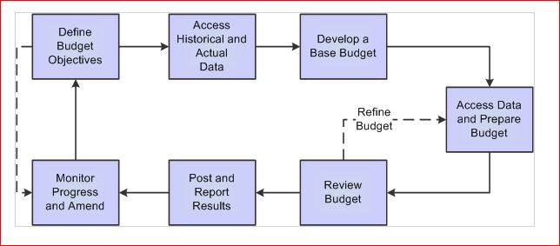
Ahsanullah University of Science & Technology
IPE 4111: Industrial Management
Budget Planning:

Slide 5


Ahsanullah University of Science & Technology
IPE 4111: Industrial Management
The use of budgets to control an organization’s activities is
known as Budgetary Control.
Must be aligned with the organizational goals
May cause misinterpretation to management
Data collection and reporting
Must be carefully designed and controlled
4

Slide 6




Ahsanullah University of Science & Technology
IPE 4111: Industrial Management
Think and Plan
about Future
Increased
communication
Uncover potential
bottlenecks
Advantages
Defined
responsibility
Resource
Allocation
Motivating Employees
5

Slide 7

Ahsanullah University of Science & Technology
IPE 4111: Industrial Management
Compels management to think about the future, which is probably the most important feature of a budgetary planning and control system. Forces management to look ahead, to set out detailed plans for achieving the targets for each department, operation and (ideally) each manager, to anticipate and give the organization purpose and direction.
Promotes coordination and communication.
6

Slide 8

Ahsanullah University of Science & Technology
IPE 4111: Industrial Management
Clearly defines areas of responsibility. Requires managers of budget centers to be made responsible for the achievement of budget targets for the operations under their personal control.
Motivates employees by participating in the setting of budgets.
Improves the allocation of scarce resources.
Economizes management time by using the management by exception principle.
7

Slide 9




Ahsanullah University of Science & Technology
IPE 4111: Industrial Management
Top-Down budget
Bottom-Up budget
Top Management
Middle Management
Middle Management
Supervisor
Supervisor
Supervisor
Supervisor
8

Slide 10


Ahsanullah University of Science & Technology
IPE 4111: Industrial Management
Two budgets are never going to be same
Top-Down budget
Managers estimate overall project cost as well as cost of major
subprojects
Lower levels breakdown the estimates for the specific tasks
Mainly prepared based on “considerable past experience”
Bottom-Up budget
Elemental tasks, schedules and individual budgets are constructed following Work Breakdown Structure (WBS)
People related to work are consulted regarding times and budgets for accuracy
Start with estimating in terms of resources, e.g., labor hr, material
8

Slide 11




Ahsanullah University of Science & Technology
IPE 4111: Industrial Management
First, senior management needs to increase top-down budget Next, junior team involved in real work reduces bottom-up budget
If negotiation point is not reached
If low impact at final stage,
accept the seniors’ one
If high impact at final stage,
accept the juniors’ one
9

Slide 12


Ahsanullah University of Science & Technology
IPE 4111: Industrial Management
14

